Slide 1
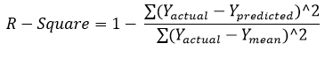
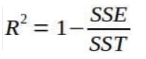





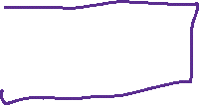



R Square / Coefficient of Determination/ Goodness of fit
It estimates the ratio of the variance of the dependent element described by the target element. It’s used for finding the accuracy of the model. It depicts the closeness of the data points to the trend line made by the model. This helps to make a link between the independent element and the target element. R square is from zero to one. The nearer R square is to one, the more accurate the model.

Slide 2



























Polynomial Regression

Slide 3




















Slide 4
Moving Beyond Linearity:
The linearity assumption is good in many machine learning problems.
However, there are other methods that offer a lot of flexibility, without losing the ease and interpretability of linear models
Polynomial regression

Slide 5
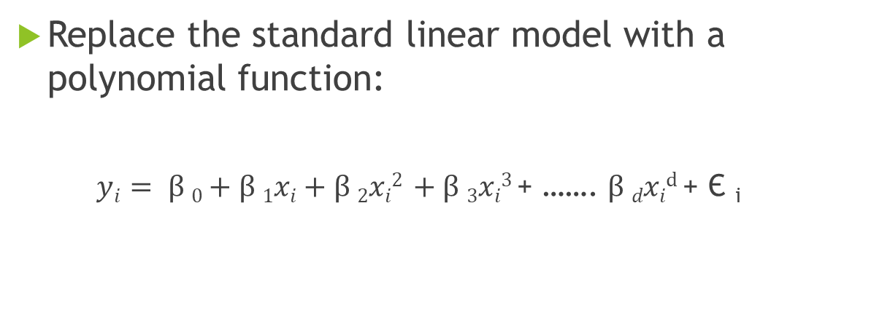
Polynomial Regression:
Replace the standard linear model with a polynomial function:
$yi= β 0+β 1xi+β 2xi2 +β 3xi3$ + ……. $β dxid$ + Є _{i}

Slide 6
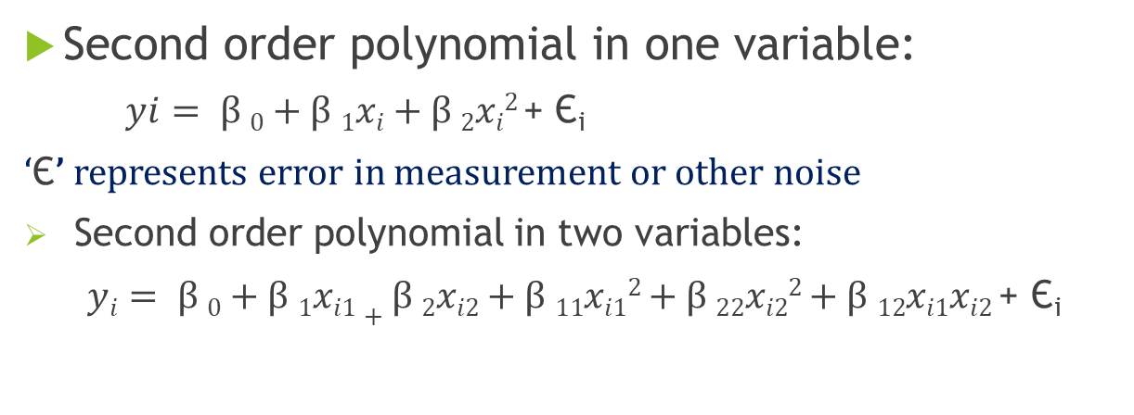
Polynomial Regression:
Second order polynomial in one variable:
$yi= β 0+β 1xi+β 2xi2$+ Є_{i}
‘Є’ represents error in measurement or other noise
Second order polynomial in two variables:
$yi= β 0+β 1xi1+β 2xi2+β 11xi12$ $+ β 22xi22$ $+ β 12xi1xi2$ + Є_{i}

Slide 7
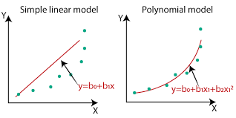

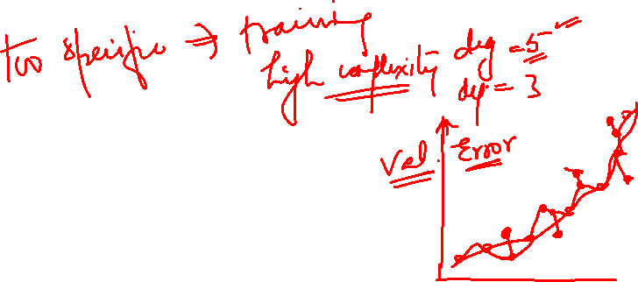
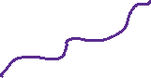


Slide 8
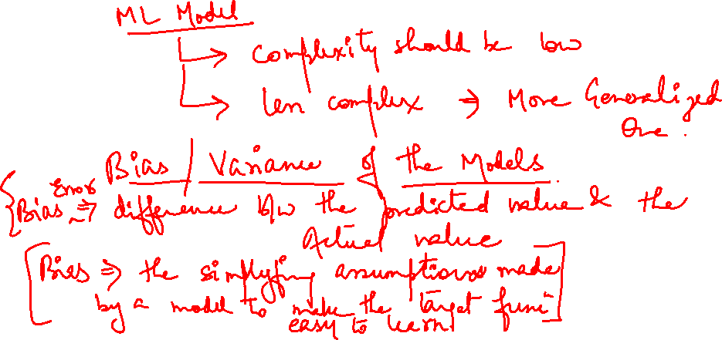

Slide 9
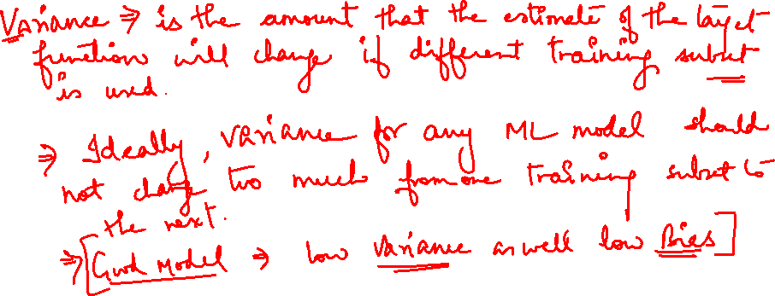

Slide 10
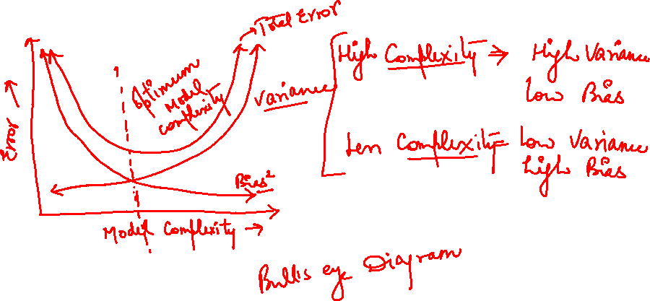

Slide 11
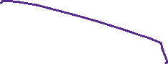



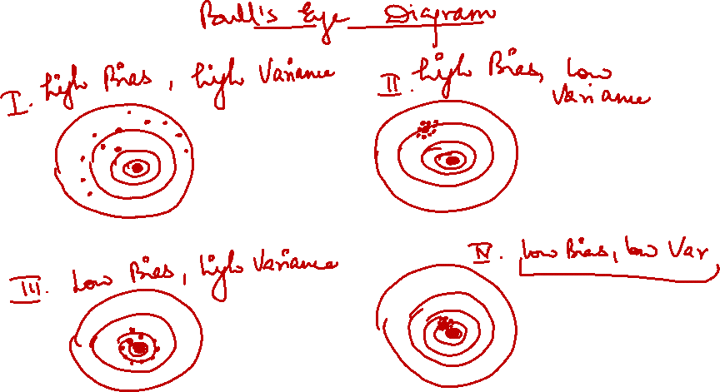

Slide 12
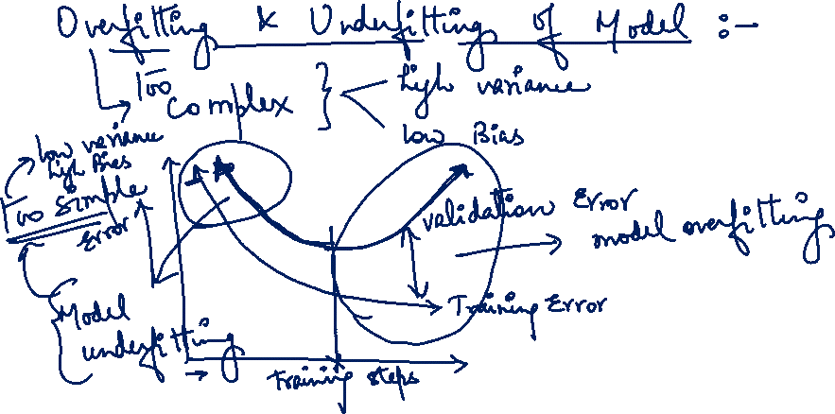

Slide 13

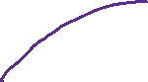

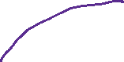

Slide 14
























Slide 15
Order of the Polynomial Model:
The order (k) should be as low as possible.
The high-order polynomials (k > 2) should be avoided unless they can be justified for reasons outside the data.
Complex models can result in “model overfitting”

Slide 16
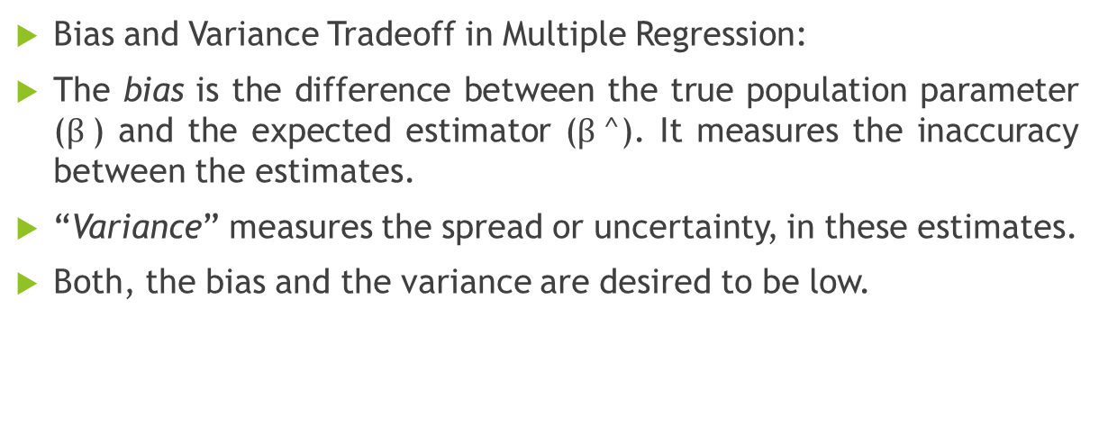
Regularization in Regression Models:
Bias and Variance Tradeoff in Multiple Regression:
The bias is the difference between the true population parameter ($β$) and the expected estimator ($β$^). It measures the inaccuracy between the estimates.
“Variance” measures the spread or uncertainty, in these estimates.
Both, the bias and the variance are desired to be low.

Slide 17
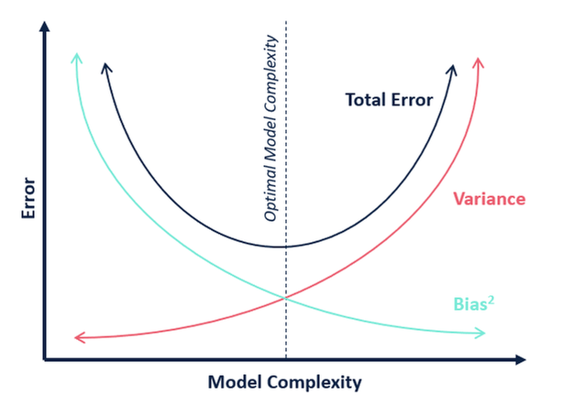

Slide 18








Regularization in Regression Models:
Regression estimator can have huge variance that results due to:
too many predictors
Predictors are highly correlated with each other.
Solution:
Reduce variance at the cost of introducing some bias. This approach is called “Regularization”

Slide 19






Regularization in Regression Models:
Ridge Regression
Lasso Regression
Elastic Net

Slide 20





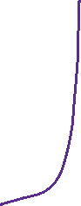






Ridge Regression
Instead of forcing the predictors to be zero (i.e. removing them from the model), ridge regression penalize them if they are too far from zero.
Thus, forcing the predictors to be small in a continuous way.
This way, it decreases model complexity while keeping all variables in the model.
Also, called as L2-penalty.

Slide 21

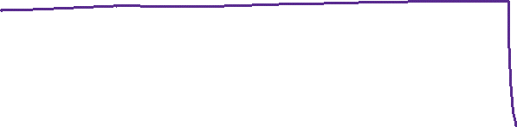




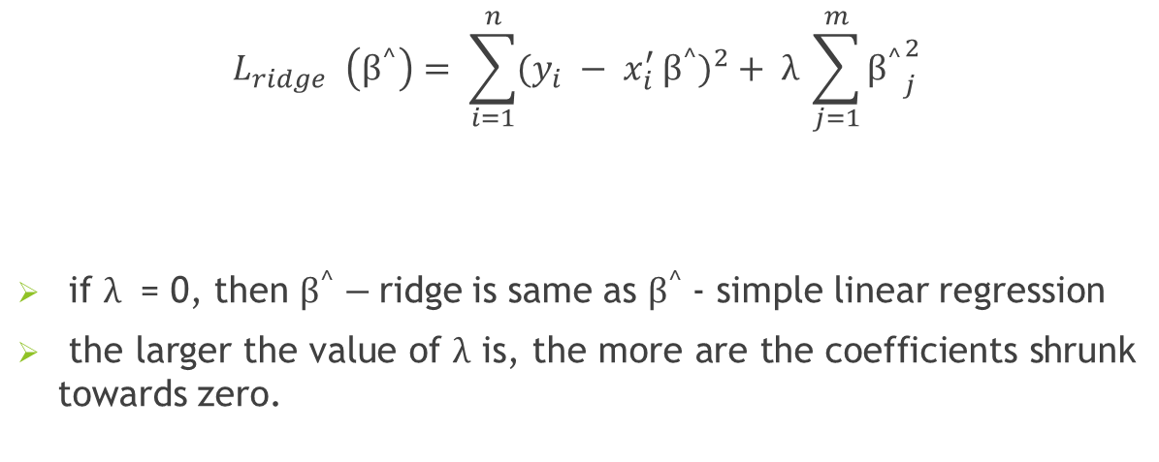

Ridge Regression
$$L_{ridge }\left(β^{^}\right)= \sum_{i=1}^{n}{{(y_{i} − x_{i}^{′ }β^{^})}^{2}}+ λ \sum_{j=1}^{m}{{β^{^}}_{j}^{2}}$$
if $λ$ = 0, then $β^{^}−$ridge is same as $β^{^}$- simple linear regression
the larger the value of $λ$ is, the more are the coefficients shrunk towards zero.

Slide 22








Slide 23
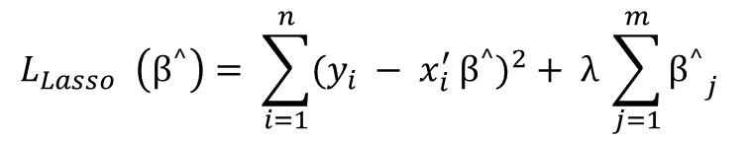



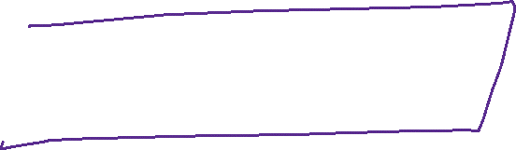
Lasso Regression (Least Absolute Shrinkage and Selection Operator)
Similar to ridge
Unlike ridge regression which penalizes sum of squared coefficients, it penalizes the sum of their absolute values.
L1 penalty
$$L_{Lasso }\left(β^{^}\right)= \sum_{i=1}^{n}{{(y_{i} − x_{i}^{′ }β^{^})}^{2}}+ λ \sum_{j=1}^{m}{{β^{^}}_{j}^{}}$$

Slide 24







Elastic Net
Combines ridge and lasso

Slide 25







































Slide 26








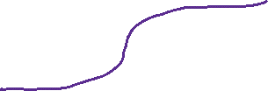

Slide 27























Slide 28

















Slide 29










Slide 30








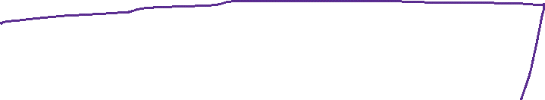






Slide 31










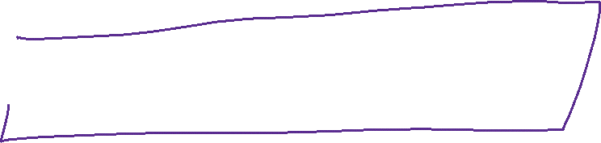



Slide 32












Slide 33










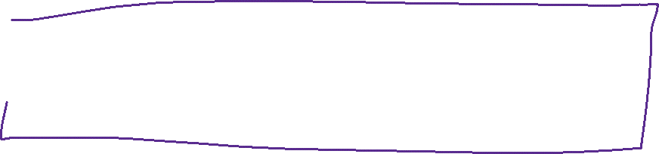






Slide 34

















Slide 35









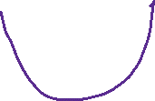


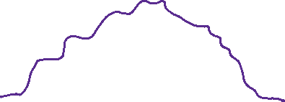

Slide 36











Slide 37


















Slide 38








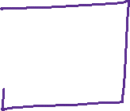








Slide 39










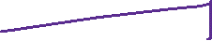


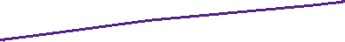






Slide 40
















Slide 41










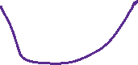









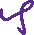



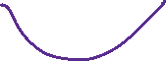



Slide 42








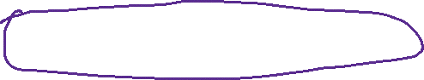







Slide 43




















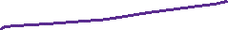



Slide 44



















